Slide 1
House recommendation platform
Agenda:
Scope
Data discussion
Current progress & next steps

Slide 2
Good looking slide - Presentation body

Slide 3
Project Description
Target |  | Airline passenger smart assistance using google ecosystem
Steps | Product design | Data analysis and insight gaining
 | Product development | Solutionize insights from step 1
 | Launch and loop | Productionize in app and integrate feedbacks in steps 1 & 2.
Involved tech |  | Generative AI, deep learning, NLP, rule base decision
step 1
step 2
step 3
Product design
Product development
Launch and loop
Notes:
Overview of what we will achieve - airline pass smart assistant
Product design - understand what is required in a design sprint to understand req for product
Development - train models and fine tune LLMs, and rules for decisions
Deploy - into cloud and get feedback from actual users, then iterate on Prod design or Prod Dev

Slide 4














E-Commerce:
Search engine
Customer service and sales chatbot
Cybersecurity:
Data protection
Incident detection
Assistants:
Voice assistance
Smart home devices
Finance:
Fraud detection
Credit attribution
Computing:
Chip power allocation.
AI in industries
Navigation:
Path proposal
Traffic estimation
Gaming:
Human-like NPCs.
Gaming gears
Robotics:
Manufacturing robots
Agriculture:
Soil deficiencies detection.
Cereal growth monitoring.
Sport:
Player performance tracking.
Match prediction
Automotive:
Self-driving vehicles.
Driving assistant.
Healthcare:
Cancer / tumor detection.
Drug discovery
Surgical operation assistant.
Social Media:
User recommendations
Newsletter personalisation
Picture filters
Personalized ads.

Slide 5
Scope
Project Description
Target |  | Hands free translation application development
Data | Input | Conversation
 | Output | Transcribed conversation
Considered tech |  | Deep learning, NLP, Generative AI
step 1
step 2
step 3
Architecture design
Model development
Deployment & evaluation
Workflow design
Data gathering
Model implementation
Model performance
Cloud preliminary deployment
Evaluation

Slide 6

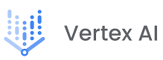
Project Description
Product design
Product development
Launch and loop
UI / UX design
Dataset creation
AI modelling
Evaluation
Relevant data processing and filtering
Model training
LLM finetuning / prompt engineering
Logic evaluation
Model evaluation
Notes:
Slide about product design development.
Target: AI lifecycle. Create AI model / finetune LLM using airline passenger data and evaluate them.
Notes:
UI / app UX also included in this sprint

Slide 7

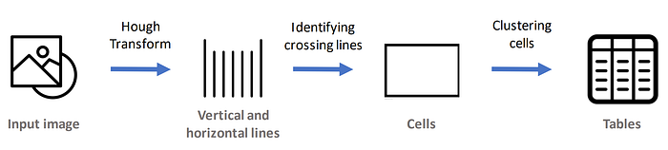



Project Description
Data parsing
Data analysis
Error analysis
Prompt engineering
text
Positioning analysis
Error detection
Parsing
Slide items
table
image
table
text
image

Slide 8

Scope
Project Description
Approach 1: Sequential processing
Audio signal processing
Spoken language detection
Database saving
Conversation
Speech to text
Correction & summary
Display to user

Slide 9
AI modelling
I.1. Model training - Face multiclass classification
0.2873 seconds
Average over 100 pictures
Load image
Find face
Get face embeddings
Predict tag
0.0149 sec
0.193 sec
0.076 sec
0.0035 sec

Slide 10

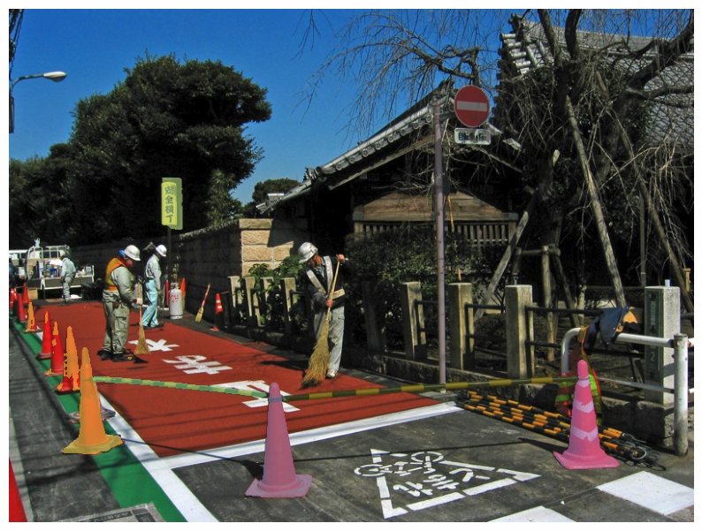
Project Description
Image training dataset
AI modelling
Available
yes
no
Net data
Cityscape
Kitti
Net data collection
Original data
Data collection
Data annotation
Data evaluation
Hope to get minimum of 2.500 picture as training data.
Notes:
Based on the provided sentence, it appears that there is a protection barrier on the side of the road consisting of two poles. Potential risks for workers in this scenario could include:
Collisions with vehicles: Workers near the protection barrier may be at risk of being struck by passing vehicles, especially if the barrier is not highly visible or if drivers are not attentive.
Falls or trips: If the area around the barrier is uneven or cluttered, workers may be at risk of tripping or falling while working in close proximity to the poles.
Struck by objects: If the barrier is not securely installed or if there are loose objects nearby, workers could be at risk of being struck by falling poles or other objects.
Exposure to traffic hazards: Despite the presence of the barrier, workers may still be exposed to hazards from passing traffic, such as excessive noise, dust, fumes, or debris kicked up by vehicles.
Inadequate visibility: If the barrier does not have appropriate reflective markings or warning signs, workers may not be easily visible to drivers, increasing the risk of accidents.
Electrical hazards: If the poles are part of an electrical system or if there are nearby power lines, workers could face the risk of electric shocks or contact with live wires.
It's important to note that these potential risks are based on the information provided and may not cover all possible hazards. The specific circumstances, work environment, and safety measures in place would need to be considered for a comprehensive assessment of risks.

Slide 11

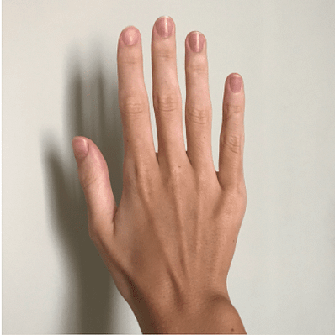


I. Technical approach - Credit card approach
User input
AI analysis system
Nail & hands measurement (pixels)
Hands & nails segmentation
Nails measurement
Credit card dimension
(pixels to cm)
Tentative models:
UNet, PSPNet
Necessary data:
500+ data points including
pictures of hands + nail + CC & hand mask + CC mask.
nails measurements.
Required data
AI model

Slide 12
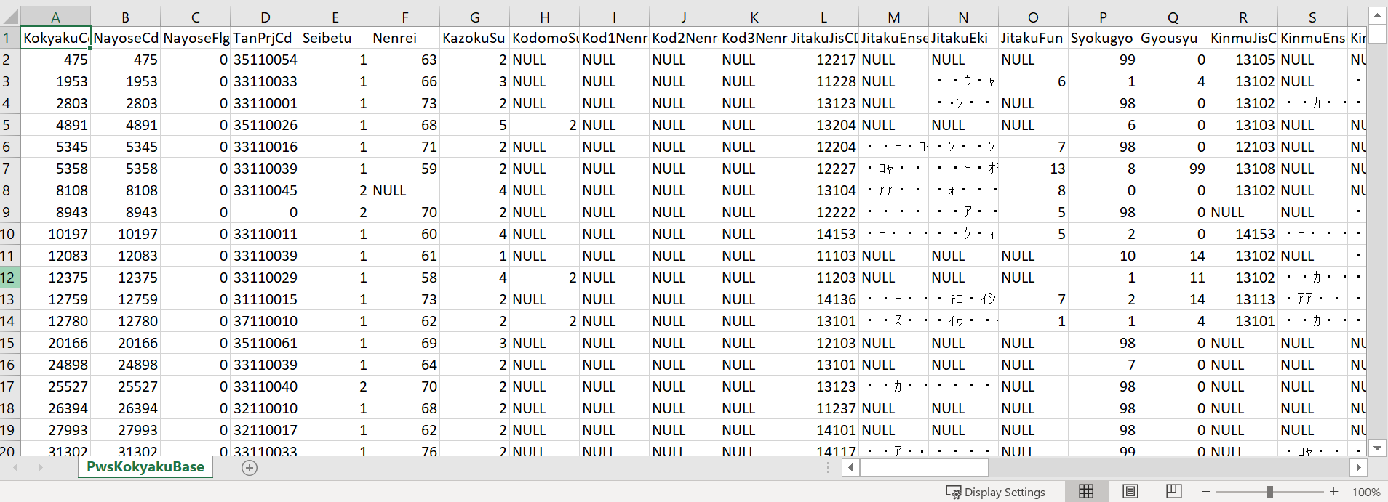
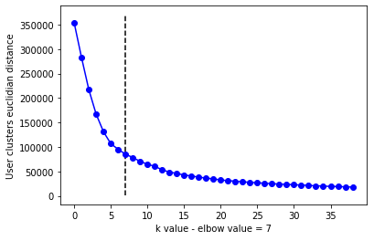
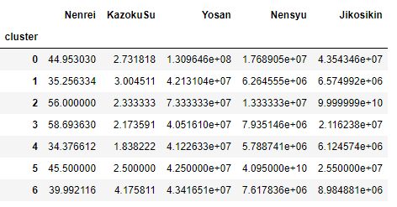

Project: Real-estate recommendation system
II. User data analysis
User type 0:
High income, 2-3 kids, 45 y.o.
Profile:- Family with highschool kids.
- Paying money for kid education.
User type 1:
Average income, 3 kids, 35 y.o.
Profile: - New family (kids, under 10 y.o. probably).
- Saving money for kids education.
User type 2:
High income, 2 kids, 55 y.o, lot of saving.
Profile: - Family with independent kids.
- Moving to a more convenient house location.
User type 3:
Average income, 2 kids, 60 y.o, few savings.
Profile: - Similar to user type 2 but lower finance.
User type 4:
Average income, 2 kids, 35 y.o.
Profile: - New family with 2 kids or less.
- First house.
User type 5:
Very high income, 2-3 kids, 45 y.o.
Profile: - High class. Can afford a lot.
User type 6:
Average income, 4 kids, 40 y.o,.
Profile: - Large family
- Focus on kids education/wellness.
User profile analysis:

Slide 13
A tricky way to start using (VR/AR) apps Barriers in ranking order
No time to search and download
High prices on apps
Lack of good apps
1
2
3
4
Low awareness of which apps are in market
6
5
Partner has issues if using more apps
Difficult to learn how to use apps
Apps are not adapted to elderly
7
8
9
App
Difficult to find and download apps
Have nobody to ask to get help
Source: Ericsson ConsumerLab Analytical platform, Senior study, October 2019
Base: Online population aged 65-74 years within Canada, China, Germany, Italy, Japan, Sweden. UK and US

Slide 14
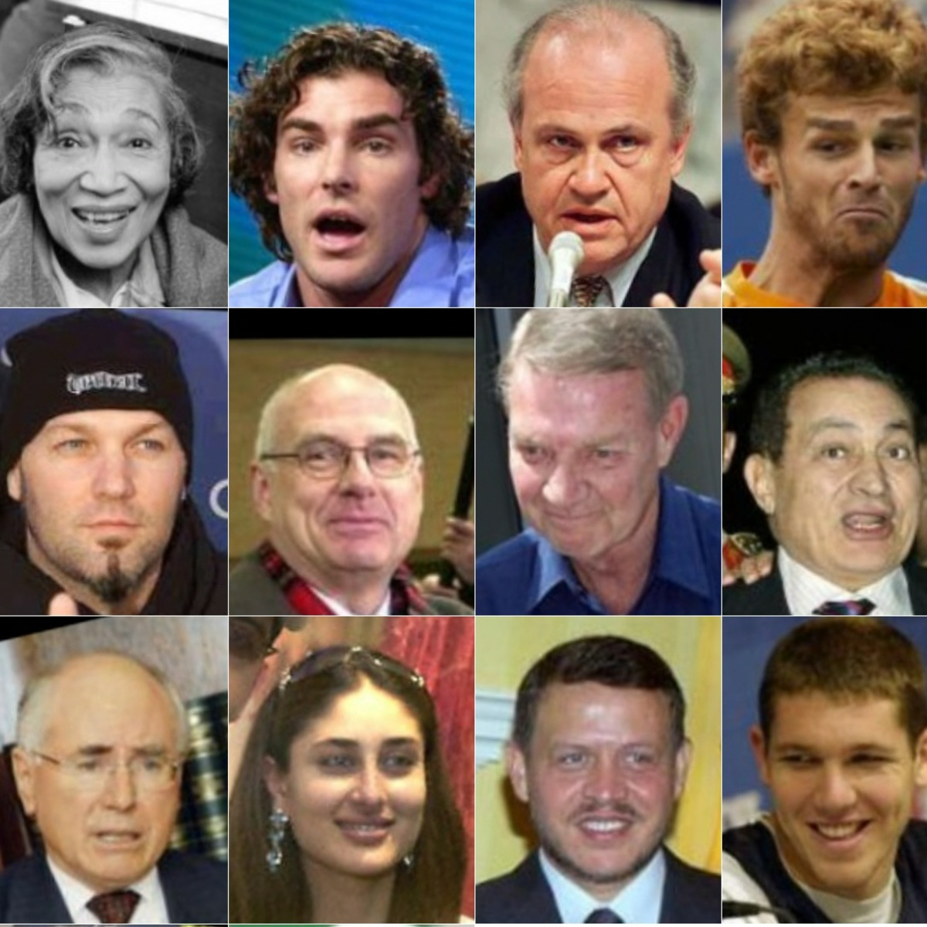
SPIKE. iOS Shared Certificates - Model evaluation over real face data
1.a. Dataset:
Load the Labeled Faces in the Wild (LFW) people dataset (classification).
Classes (num person) | 5749
Samples total (num pictures) | 13233
RGB pictures | real, between 0 and 255

Slide 15
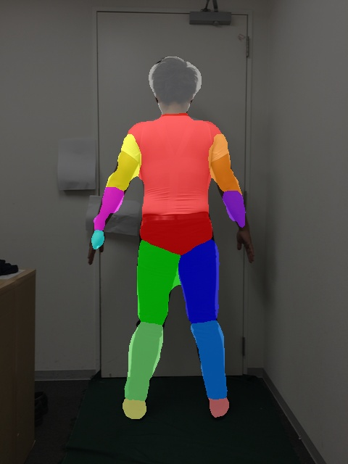
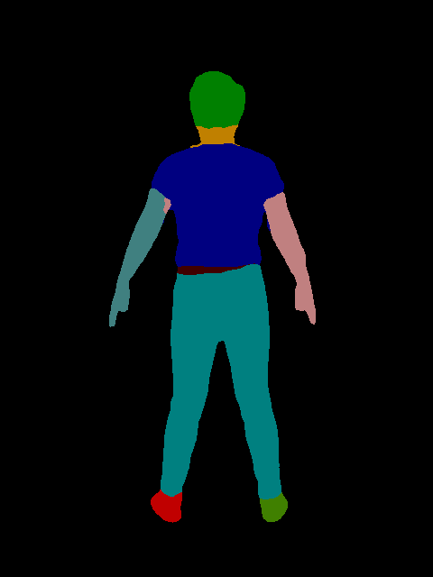
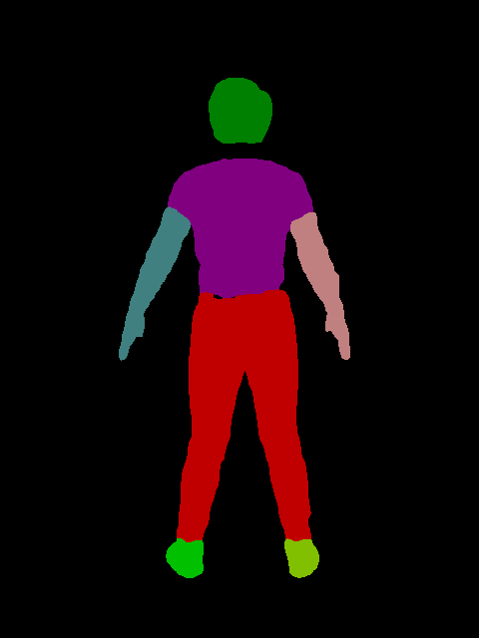
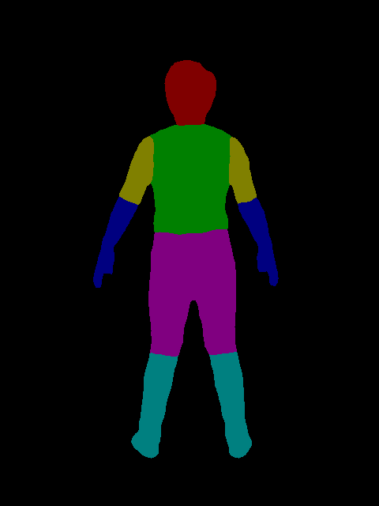
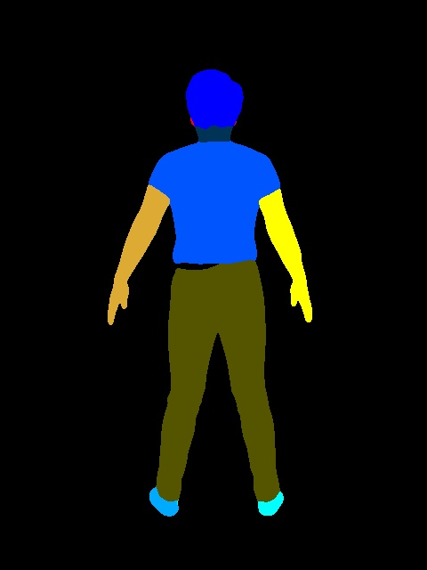
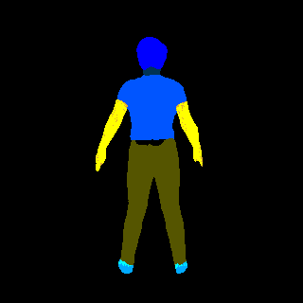


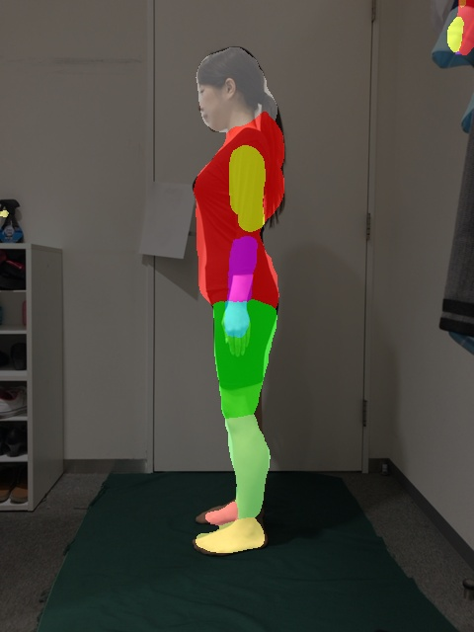
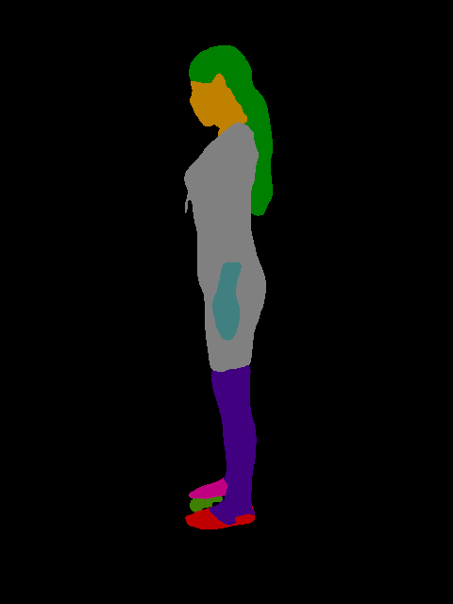
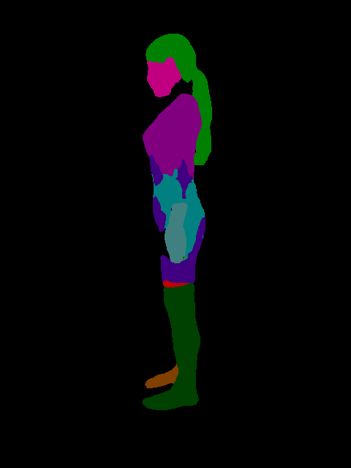
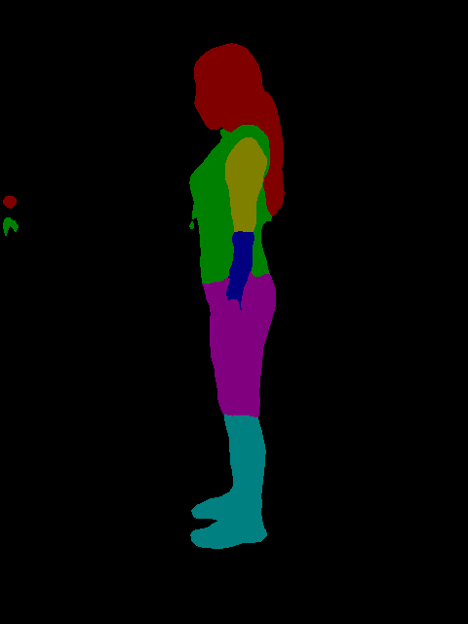
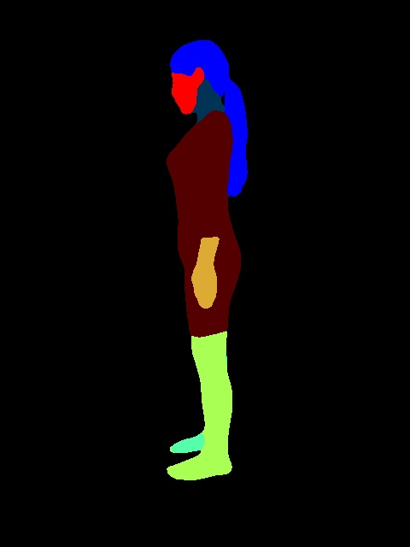
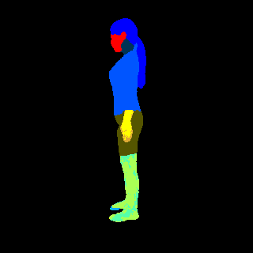
II. Body segmentation - Model comparison
AI report
Cross-Domain Complementary Learning | Self-Correction Human Parsing | Graphonomy | Look Into Person
ATR
LIP
Pascal-person
‹#›

Slide 16
Technical concepts

Slide 17
Estimation of body dimensions using deep learning models
Data pipeline
Training pipeline
Data collection & Cleaning
Data Storage
API building
Analysis
Prototype development
Productionization
Launch & Maintenance
Data Engineering / Infrastructure
MLOps
Data Science / Machine Learning Engineering / Business intelligence / Analytics
In AI projects, the main blocker often comes from data part as you might not have enough data to train a model or no data at all.
It is a good idea then to try pre-trained models that were trained on large dataset (ImageNet, COCO, Kitti) by other and has free to use license.
MIT License: This is an agreement commonly used by software developers when they release Free and Open Source software.
GNU General Public License: This is a series of widely used free software licenses that guarantee end users the freedom to run, study, share, and modify the software.
Introduction
Data issue
Preliminary investigation
Selected approach & results
Improvements
Issues

Slide 18

I. Modelling approaches - Training from scratch
AI proposal
Large dataset
AI model training
Inference

Slide 19

I. Modelling approaches - Fine tuning
AI proposal
Other people’s work
AI model training
Large dataset
Our work
Own dataset
Fine tuning
Inference
Inference

Slide 20

I. Modelling approaches - Few shot learning
AI proposal
Other people’s work
AI model training
Large dataset
Our work
Own dataset
Few shot learning
Inference

Slide 21
I. Modelling approaches
AI proposal
Modeling approach | Training resources | Data | Model | Size of the model | Model call availability
Scratch | High need of GPU power | Need a lot of data | Transformers | Big | Local
Fine tuning | Medium need of GPU power | Need limited amount of data | Transformers | Big | Local
Few shot learning | Low need of GPU power | Need just data we want to cover | Transformers or ChatGPT | Big | API call

Slide 22
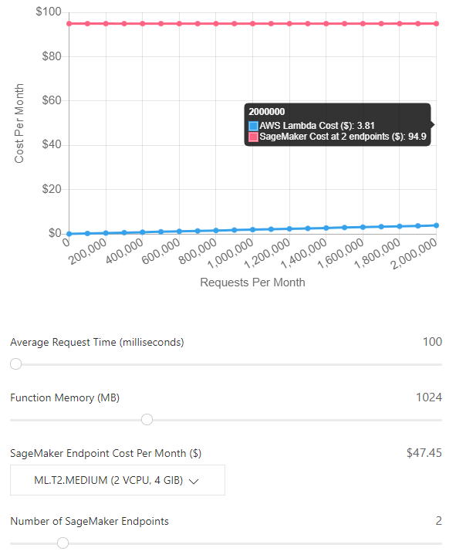
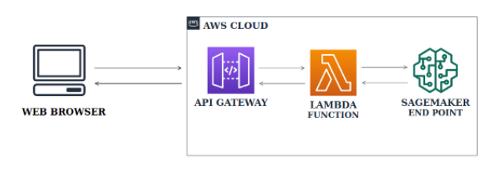
II. - AWS cost
Only 3,008 MB physical memory and no GPU acceleration.
Cold start latency (5–10 minute period of inactivity).
Package size limits (50 MB zipped and 250 MB unzipped).
Lambda has a pay-per-request model that scales with your growth. Whether this is a pro or con depends on your usage level, but is especially cost-efficient for serving under 2M predictions per month. SageMaker, as of this writing, does not support auto-scaling to zero during periods of low activity.
Lambda requires a simpler implementation computational model where concurrency/autoscaling can be handled transparently outside of your logic.
Lambda requires lower maintenance effort, without any underlying servers or logic to manage.
Lambda has a rich developer ecosystem (both open-source and SaaS) for monitoring, logging, and testing serverless applications, such as Serverless. With SageMaker, you’re relying on AWS-specific resources such as the SageMaker-compatible containers and SageMaker Python SDK for tooling.
‹#›

Slide 23
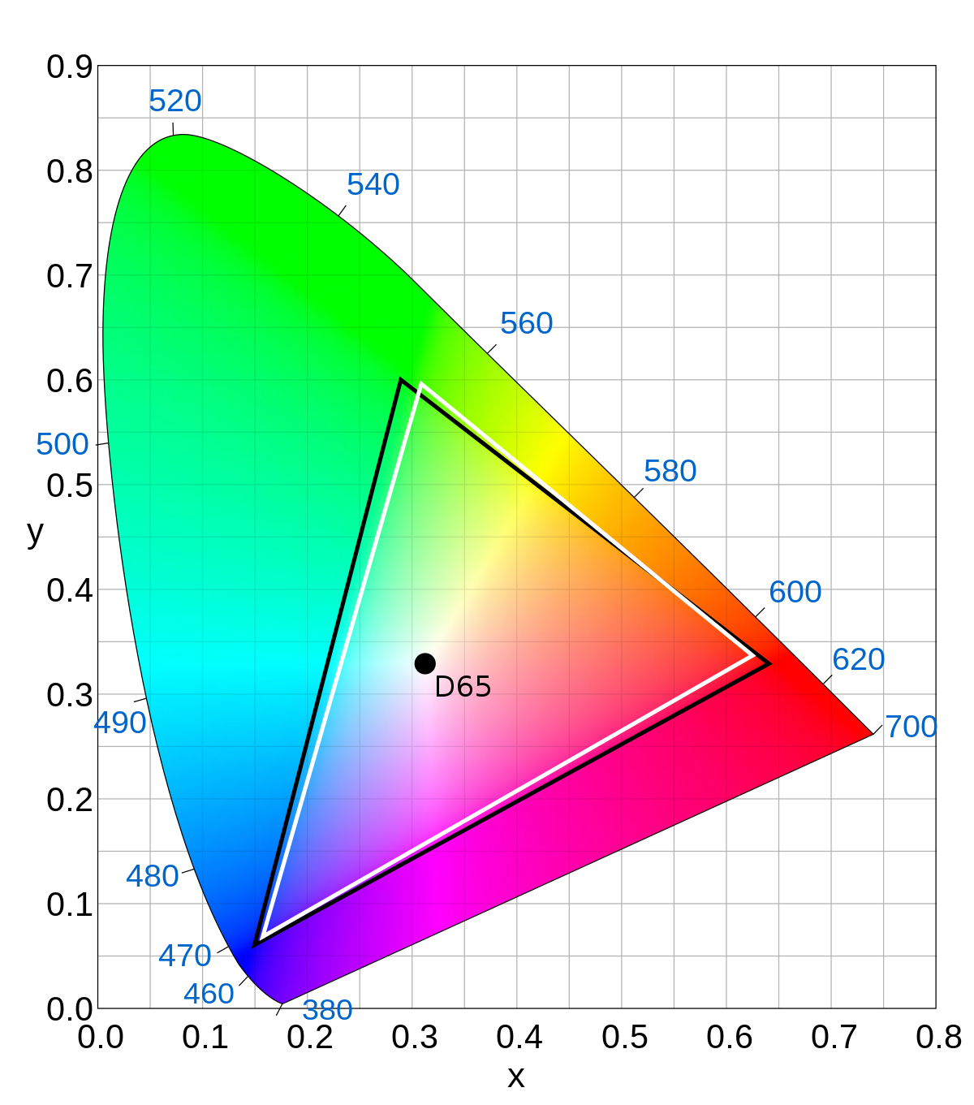
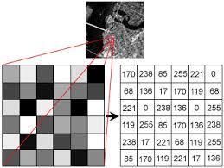
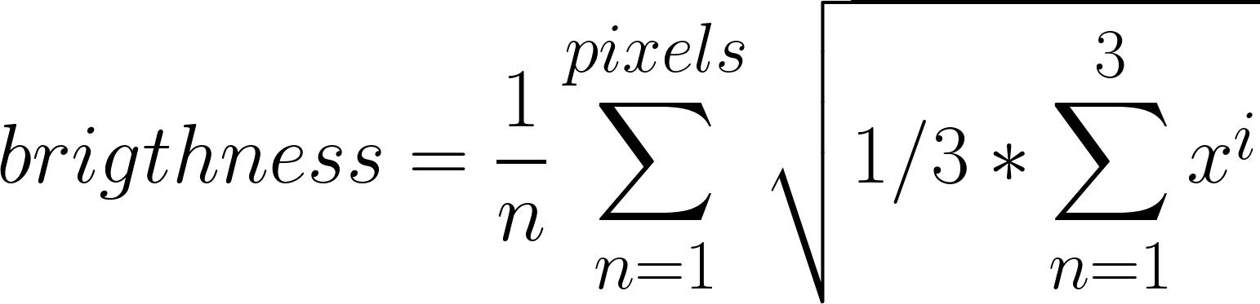
Face authentication
Content
Average brightness
Perceived brightness (luminance rec 601)
The Rec. 601 standard, also known as CCIR 601 or ITU-R BT.601, is a standard for standard-definition television (SDTV). It defines the coefficients for converting RGB values into the Y'CbCr color space.
The average pixel intensity in an image can be computed by averaging the values of all the pixels in the image.

Slide 24
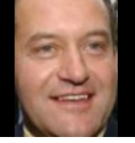
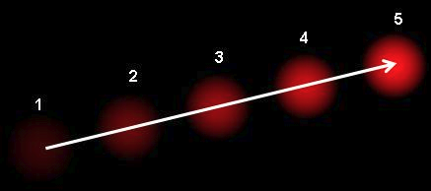
Liveness check - Possible improvements
Content
Optical flow analysis to track keypoints in successive images and see some relevant patterns using harmonic analysis of x and y motions of these keypoints.
Source:
https://docs.opencv.org/3.4/d4/dee/tutorial_optical_flow.html

Slide 25
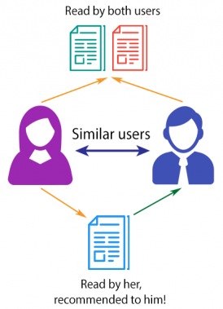
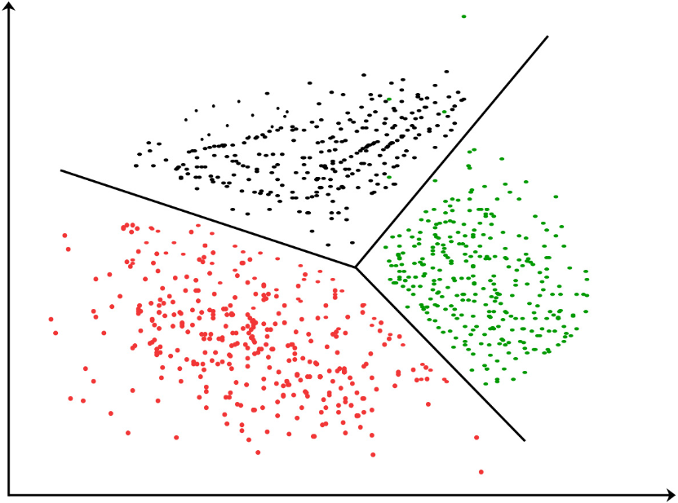
Project: Real-estate recommendation system
I.1 - Collaborative filtering via clustering
First approach aims to use clustering algorithms to propose house to users via collaborative filtering.
Definition:
Collaborative filtering algorithms aim to analyze information about users with similar tastes to recommend a known liked product by one user to another similar user.
Definition:
Clustering is the task of dividing the population or data points into a number of groups such that data points in the same groups are more similar to other data points in the same group.
Clustering approach is used because of the number of users: one model for each user increases the complexity of the system and storage requirements.
I.1 - Collaborative filtering
I.2 - A/B testing
II - Use case
III - To be done

Slide 26
Face recognition - Gamma correction - Initial test
Content
1. Calculate brightness of to be compared images as the average of per-pixel euclidean norm.

Slide 27
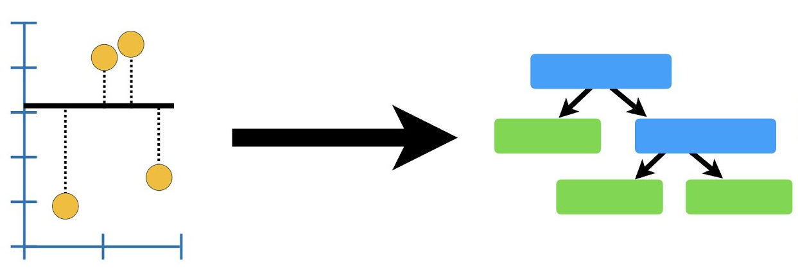
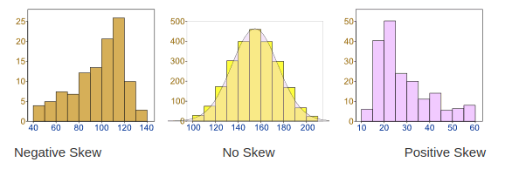
Project: Positioning & irradiation time prediction
Base model + input data unskewing.
Model:
XGBOOST - Build a strong classifier from several weak classifiers in series. Proved to be the best performing regression framework for machine learning applications.
Base model:
Hyperparameters set by default by the library implementation (learning rate, maximum evaluation, tree depth, ...).
Advanced model:
Optimize model hyperparameters so that they decrease the mean average error of validation data.
Data unskewing:
Check transformation that reduces data skewness:
Log
Squared
No transformation
Feature selection:
Select input data that has a certain of degree of correlation (pearson coefficient) with predicted data. It removes unnecessary data from training phase.
Cross validation:
Change the training data content so it produces better results (MAE wise).
‹#›

Slide 28
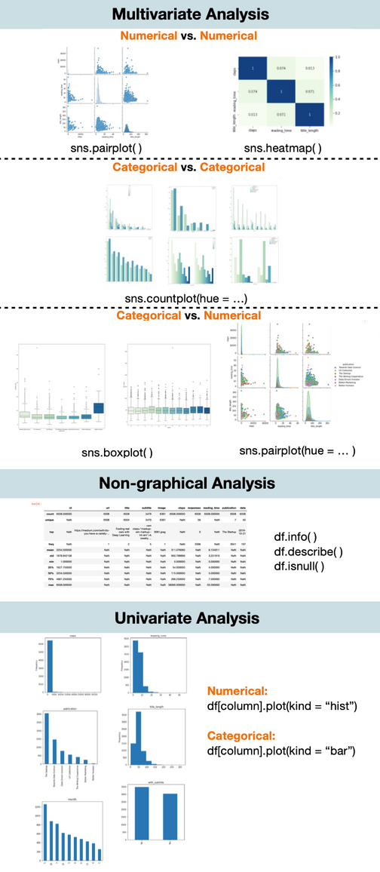
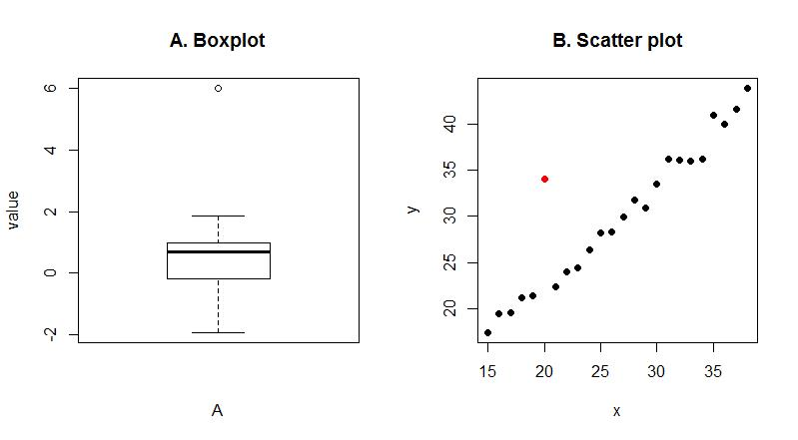
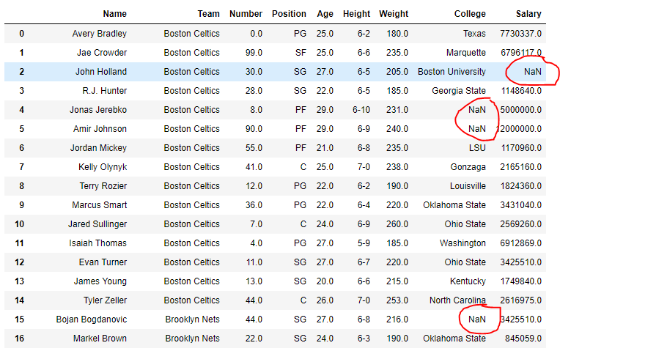
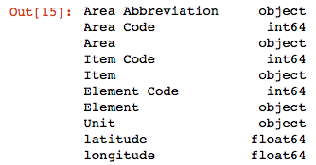
Investigate data content
Exploratory data analysis is a way to explore possible data errors, such as missing data, wrong data types, out of context data, and outlier data using statistical graphics and other data visualization methods. It is an important step in the data engineering step since data given to a model should be standardized.
Outliers are extreme values that are outside the range of what is expected and unlike the other data. Outliers can have many causes, such as measurement or input error, data corruption or true outlier observation (e.g. Michael Jordan in basketball).
Often machine learning modeling and model skill in general can be improved by understanding and even removing these outlier values.
Missing values are one of the most common problems when you preparing data for machine learning. The reason for the missing values might be human errors, interruptions in the data flow, privacy concerns, etc. Whatever the reason, missing values affect the performance of machine learning models.
Data type are used to classify one particular type of data. They are usually a mixture of integers, float, strings, and booleans (non exhaustive list). When manipulating data, their type should be coherent so they do not cause numerical issues during the training process. The reason behind having different data types for a single data entry might be conversion error, missing data or human error.

Slide 29
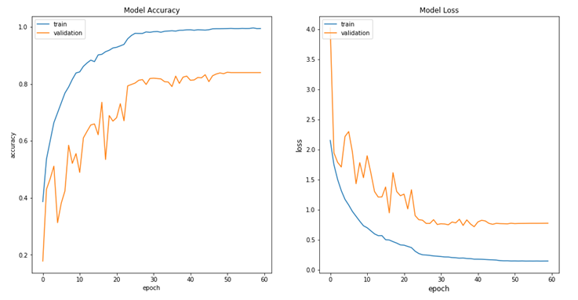
Training phase metrics
Training a model simply means determining good values for all the weights from training data. In supervised learning, a machine learning algorithm builds a model by examining many examples and attempting to find a model that minimizes a defined loss.
A loss function is defined to optimize a machine learning algorithm. The loss is calculated on training and validation data and its interpretation is based on how well the model is doing in these two sets. Loss value implies how poorly or well a model behaves after each iteration of optimization. Thus, after each training iteration, loss is calculated and the model is modified in order to tend to a loss decrease.
This loss function can also be linked with other metrics like accuracy (for classification problem), which indicates accurate a model is after each training iterations. As the loss function decrease, the model accuracy increases.
It is interesting to records these metrics so an idea on how a model performs can be quickly understood. It also serves to detect overfitting or plateauing. Overfitting is a modeling error that occurs when a model performs remarkably well only on a training data but very poorly on validation data. It is a problem that harms generalization of the model over new data. Plateauing is a modelling phenomenon where the loss value stops decreasing during the process of learning, meaning that modeling approach possibly reach limitations in term of performance. This

Slide 30
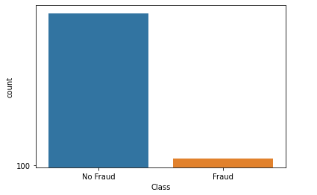
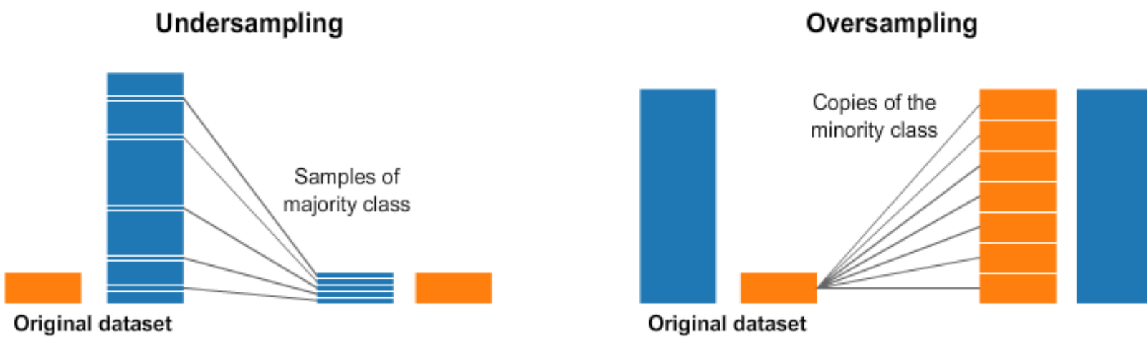
Data balance
Data balance refers to the repartition of data used for training. Imbalanced classes are a common problem in machine learning classification where there are a disproportionate ratio of observations in each class. To some extent, the same concept can also be applied to machine learning regression problem where the number of observations for regular interval of data is imbalance (data binning).
This issue results in models that have poor predictive performance, specifically for the minority class. To remedy this issue, two main techniques can be employed: oversampling and undersampling.
Under-sampling is a technique that balances the dataset content by reducing the size of the majority class to balance the class distribution. Since it is removing observations from the original data set, it might discard useful information.
Over-sampling is a technique that tries to balance the number of minority class members in the training set by incrementing the size of rare samples. The advantage of over-sampling is that no information from the original training set is lost, as all observations from the minority and majority classes are kept.
To remedy imbalance data, it is also possible to a generate artificial data from existing data, so we can balance the classes.

Slide 31
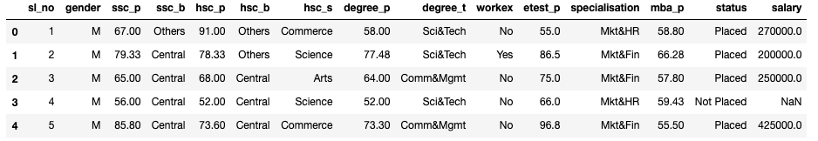
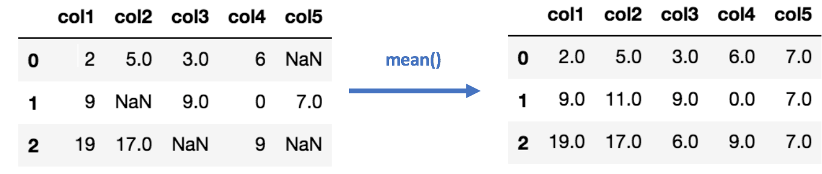
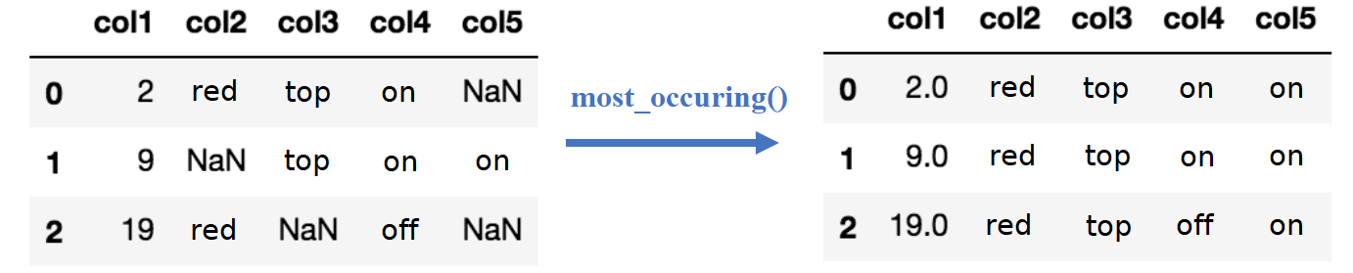
Missing values handling
Missing values also referred as Nan values (not a number) are one of the most common problems you can encounter when you prepare your data for machine learning. They are a numeric data type used to represent any value that is undefined or unpresentable. The reason for these missing values might be human errors, interruptions in the data flow, privacy concerns, etc. Whatever the reason, missing values affect the performance of machine learning models. Some method for fixing this problem are:
Entry drop: Dropping either columns or rows with missing data.
Numerical Imputation: Replacing the missing numerical entry with defined value that can be mean values of the entry, zero or another default value, so data size is preserved.
Categorical imputation: Replacing the missing categorical entry with defined value that can be the most occurring value or a ‘other’ default value, so data size is preserved.
Random sample imputation: Replacing the missing entry with a random observation in the dataset, so data size is preserved.

Slide 32
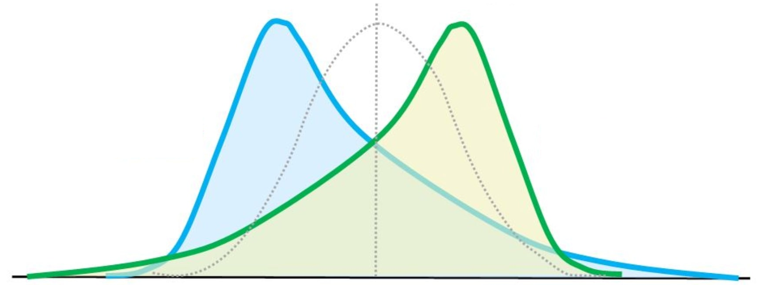
Skew and data transformation & normalization
Data skew is the degree of distortion from a normal distribution.
Data skew harms machine learning since the tail region acts as an outlier and affect the model’s performance. The issue behind this problem is related to the central limit theorem, which expresses the idea that adding random numbers from almost any distribution and add them together will get something approximately normally distributed.
In a typical machine learning problem you will have errors from many different sources (e.g. measurement error, data entry error, classification error, data corruption...) and it is common to think that the combined effect of all of these errors is approximately normal. Thus, it is necessary to transform the skewed data to close enough to a normal distribution to reduce outliers.
The best way to fix it is to transform these variables with reversible transformation, with the intent to reduce the skewness. Common transformations include square root, logarithmic, reciprocal, or boxcox.
Following data transformation, it is a common practice to normalize data in a way that they are either dimensionless. Normalization gives equal importance to each variable so that no single variable steers model performance in one direction just because they are bigger numbers. Three methods can be applied to perform data normalization, which are as follows:
Min-Max normalization:
Values are shifted and rescaled so that they end up ranging between 0 and 1.
Mean normalization:
Values are shifted and rescaled so that they
Z-score normalization:
Values are shifted and rescaled so that they

Slide 33
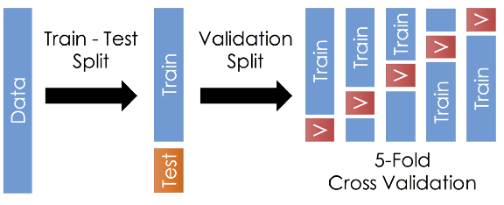
Training data - k-fold cross validation
k-fold cross validation is a procedure used to estimate the performance of a model on various sets of data.The procedure has a single parameter called k that refers to the number of groups that a given data sample is to be split into. When a specific value for k is chosen, it may be used in place of k in the reference to the model, such as k=10 becoming 10-fold cross-validation.
The general procedure is as follows:
Shuffle the dataset randomly.
Split the dataset into k groups (for example 5 fold in the graph on the right).
For each unique group:
Take the group as a hold out or test data set
Take the remaining groups as a training data set.
Fit a model on the training set and evaluate it on the test set.
Retain the evaluation score.
Summarize the performance of the model using the sample of model evaluation scores
The k value must be chosen carefully for your data sample. A poorly chosen value for k may result in a mis-representative idea of the performance of the model. The choice of k is usually between 5 to 10, but there is no formal rule. As k gets larger, the difference in size between the training set and the resampling subsets gets smaller. As this difference decreases, the bias in the data becomes smaller.
Cross validation is used in order to estimate how the model is expected to perform in general when used to make predictions on unseen data. It generally results in a less biased or less optimistic estimate of the model performance.

Slide 34
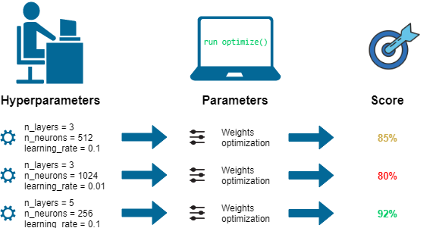
Hyperparameters optimization
Model have two type of parameters that should be tuned during the training process to achieve higher performance.
Model parameters: These are the parameters that are estimated by the model from the given data. For example, convolution kernel in deep neural networks.
Model hyperparameters: These are configurations that are external to the model and whose value cannot be estimated from data. For example, the learning rate in deep neural networks.
Model hyperparameters are tunable and can directly affect how well a model trains. So then hyperparameter optimization is the process of finding the right combination of hyperparameter values to achieve maximum performance on the data in a reasonable amount of time. In following, some method that are used to achieve hyperparameter optimisation:
Random Search
In the random search method, we create a grid of possible values for hyperparameters. Each iteration tries a random combination of hyperparameters from this grid, records the performance, and lastly returns the combination of hyperparameters which provided the best performance.
Grid Search
In the grid search method, we create a grid of possible values for hyperparameters. Each iteration tries a combination of hyperparameters in a specific order. It fits the model on each and every combination of hyperparameter possible and records the model performance. Finally, it returns the best model with the best hyperparameters.
Bayesian Optimization
Tuning and finding the right hyperparameters for your model is an optimization problem. We want to minimize the loss function of our model by changing model parameters. Bayesian optimization helps us find the minimal point in the minimum number of steps. Bayesian optimization also uses an acquisition function that directs sampling to areas where an improvement over the current best observation is likely.

Slide 35
Data mining seminar
I. Data pre-preprocessing
Exploratory data analysis is a way to explore possible data errors, such as missing data, wrong data types, out of context data, and outlier data using statistical graphics and other data visualization methods. It is an important step in the data engineering step since data given to a model should be standardized.
Outliers are extreme values that are outside the range of what is expected and unlike the other data. Outliers can have many causes, such as measurement or input error, data corruption or true outlier observation (e.g. Michael Jordan in basketball).
Missing values are one of the most common problems when you preparing data for machine learning. The reason for the missing values might be human errors, interruptions in the data flow, privacy concerns, etc.
Data type are used to classify one particular type of data. They are usually a mixture of integers, float, strings, and booleans (non exhaustive list).

Slide 36
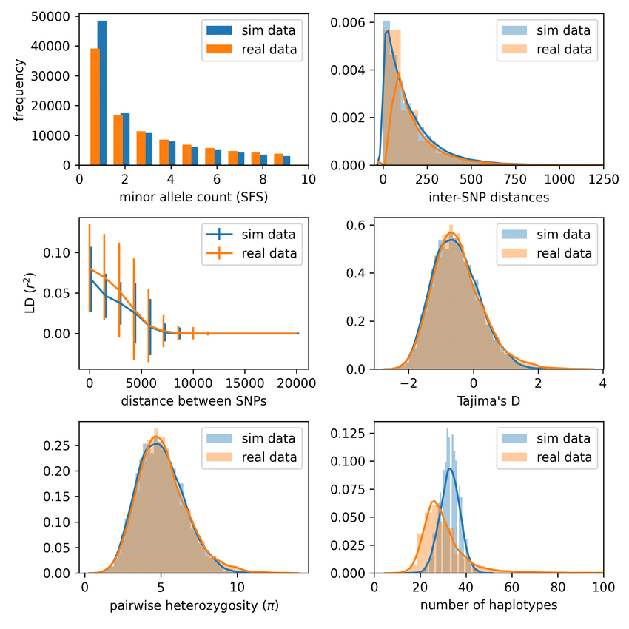
Data mining seminar
II. Exploratory data analysis
Statistics refers to a collection of methods for working with data and using them to answer questions.
Descriptive Statistics: Summarizing raw observations into information.
Inferential Statistics: Quantifying properties from a smaller set of data and applying it to larger set.
Define your target
Collect appropriate data
Analyze the data
Interpret the results

Slide 37
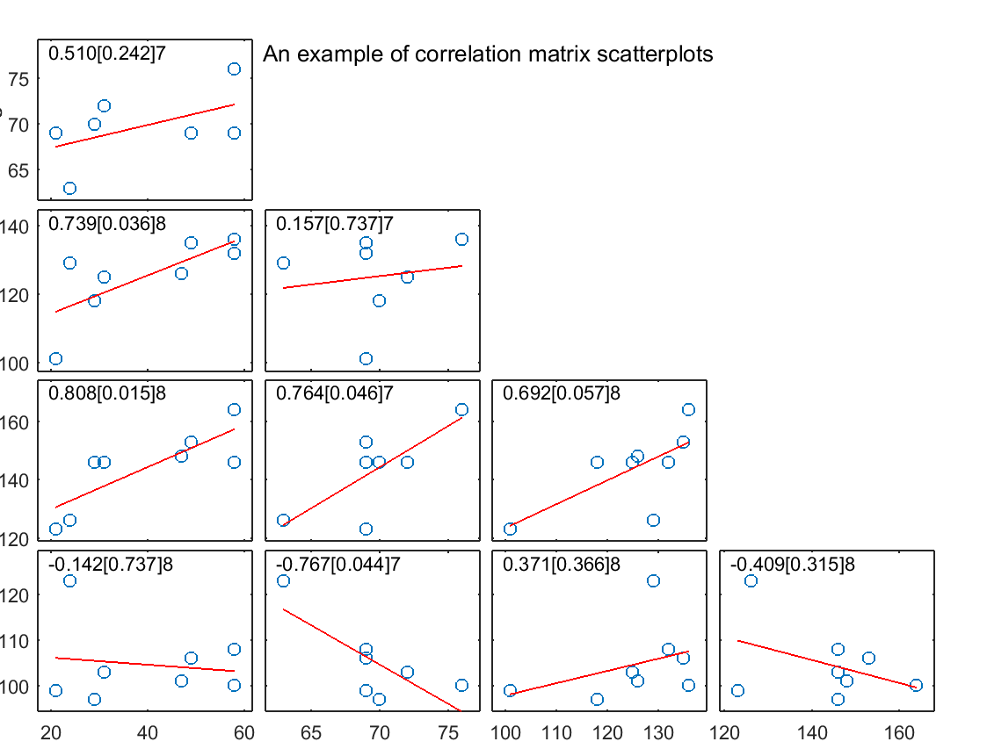
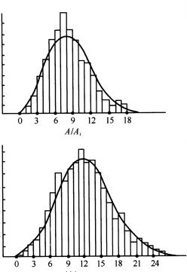
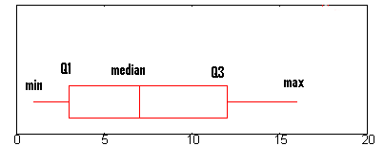
Data mining seminar
II. Exploratory data analysis
Correlation
Variability
Probability density function

Slide 38
Illustrations

Slide 39










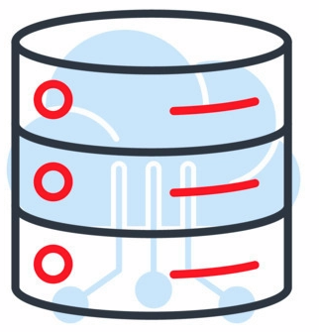















Project Description

Slide 40







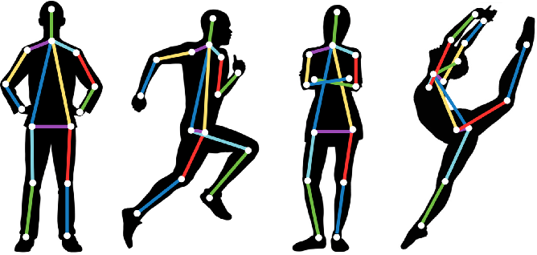





Project Description

Slide 41
Project Description
UK
US
Japan

Slide 42










Project Description
optimal threshold = 0.4831

Slide 43




Project Description

Slide 44




Project Description
From: … To: 本社
At: 08:30 AM
By 中野さん
From: … To: 本社
At: 08:55 AM
By 橋本さん
From: … To: 本社
At: 08:30 AM
By 若本さん

Slide 45










































Project Description

Slide 46



Project Description

Slide 47
Project Description
X
O
✅
❌
✔
✗
🔁

Slide 48
Conclusion, timeline & costs

Slide 49
Project Description
Done | Project tools creation Preliminary logic brainstorm Improvement points brainstorm
Issue | Data insight
To be done | Data analysis Area-wise analysis House layout wise analysis Logic flow creation in MIRO

Slide 50
IV. Timeline
Project Description
During PoC phase, considerations should be tested and evaluated in order to assess the feasibility of the task.
Strategy and metric
Data preparation
Model investigation
Implementation & optimization
Transcription to Vietnamese
Evaluation
役割 | 拠点 | 2月 | 3月 | 4月 | 合計（人月）
PM | JP | 0.5 | 0.5 | 0.5 | 0.5
AI Engineer | JP | 1.0 | 1.0 | 1.0 | 1.0
月次合計（人月） |  | 1.5 | 1.5 | 1.5 | 1.5
月次合計金額（税抜） |  | ¥ | ¥ | ¥ | ¥
Notes:
Hirata-san: GPT4 vision might come later this year so image part might be changed later. Matsuura-san: Focus on the image part to validate critical part. Might also wait for GPT4 vision.
➔ Provide cost per milestone / row of above content. Give the content before friday noon.

Slide 51
Timeline
Project Description
Tentative schedule for product design step only (step 1)
Strategy and metric
Data pipeline creation
Exploratory data analysis
Data insight investigation
Hypothesis testing
Logic creation and preliminary tests
App UI / UX design
Data scientist
Data engineer
Designer / stakeholder

Slide 52
Project: Real-estate recommendation system
9月
10月
11月
12月
1月
2月
リリース予定
AIチーム
データ分析、レコメンド方針調整
検証
※ AIエンジニア 1名
アドバイザー 1名
の体制を想定
設計
組込用 AI API開発
モデル更新・評価・分析調整など
インフラ検討・構築準備
既存
開発チーム
データ生成サポート
設計
LINE・API改修
※ 現時点での開発スケジュールイメージの為、レコメンド方針調整等の内容によりスケジュールが変動する可能性があります。
I - Data analysis
II - Operation workflow
II - Others

Slide 53

メンバー紹介
^{平田 大祐}
CTO / 開発リーダー
2004年に外資系大手SI企業に入社しエンジニアとして業務システム開発、インフラ構築を担当。2009年より中小ソフトウェアハウスでチーフアーキテクトとして、Webサービス, 組込み系ソフトウェア、通信系ミデルウェア、AIなどの開発実績をつむ。2015年にモンスター・ラボに入社。チーフテクノロジストとしてWebサービス、アプリ開発を中心に、エンジニアリングチームのマネジメント、技術戦略策定、オフショア開発の開発プロセス改善を担当する。
休日はよく漁港でお土産を探す。アジの干物とイカの塩辛を買うことが多い。
CTO
/Adviser
DAISUKE HIRATA
^{開発実績例}
教育関連Webサービス開発
CtoCフリーマーケットWebサービス開発
SNSデータ分析サービス開発
VoLTE ミドルウェア開発
産業ロボット用ビジュアルプログラミング開発
まもりあいJAPAN「接触確認（トレーシング）アプリ」開発 等々
^{他多数}

Slide 54

メンバー紹介
ジョリ アントナ
AI エンジニア
AI
ENGINEER
^{機械学習とディープラーニングアルゴリズムのスペシャリスト。}
東京大学の機械工学博士取得。卒業後はデータ指向シミュレーションエンジニアとして勤め始め、その後、自動運転技術の研究エンジニアとして主に車両経路の理解と予測を担当しました。
現在モンスター・ラボでは機械学習開発を担当しており、顧客ニーズを理解した上でのデータ分析や機械学習実装ソリューションを構築することに尽力しています。
JOLY Antonin
^{開発実績例}
シーン理解のためにCNNを使用したセマンティックセグメンテーションアルゴリズムの開発。
CNNを使用した画像の類似性取得のための幾何学的変換アルゴリズムの開発。
統計ツールによるデータの前処理と分析。
国際会議での複数のプレゼンテーション。

